Slide 1
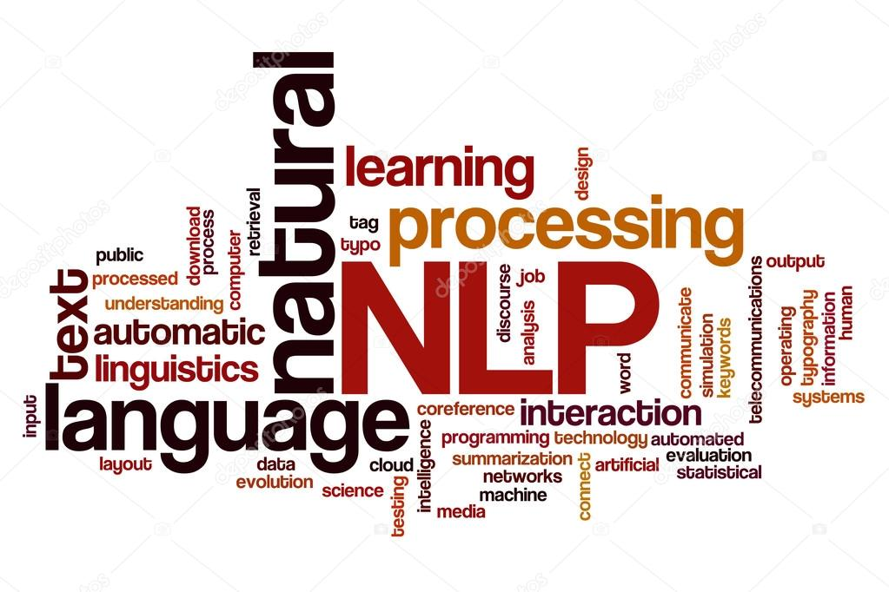
CAPSTONE CHATBOT INTERFACE
Team – 6B
Shivang Shrivastav, Amaresh Mishra, Aprajita AnAND, Sampan Naik

Slide 2
problem statement
Domain:
Industrial safety. NLP based Chatbot
Context:
The database comes from one of the biggest industry in Brazil and in the world. It is an urgent need for industries/companies around the globe to understand why employees still suffer some injuries/accidents in plants. Sometimes they also die in such environment
Objective:
Design a ML/DL based chatbot utility which can help the professionals to highlight the safety risk as per the incident description
Project Task:
Milestone 1 - Clean data as .xlsx or .csv file to be used for AIML model learning
Milestone 2 - Pickled model to be used for future prediction
Milestone 3 - Clickable UI based chatbot interface which accepts text as input and replies back with relevant answers

Slide 3
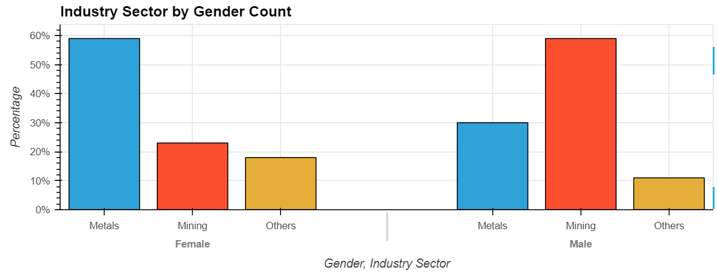
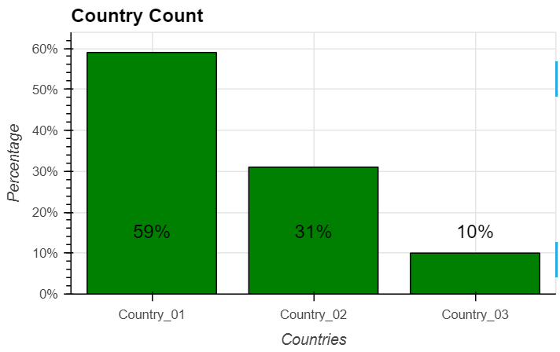
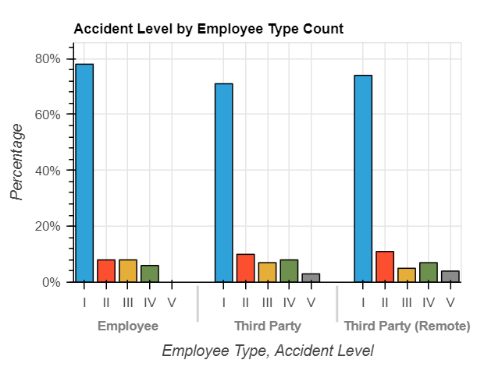
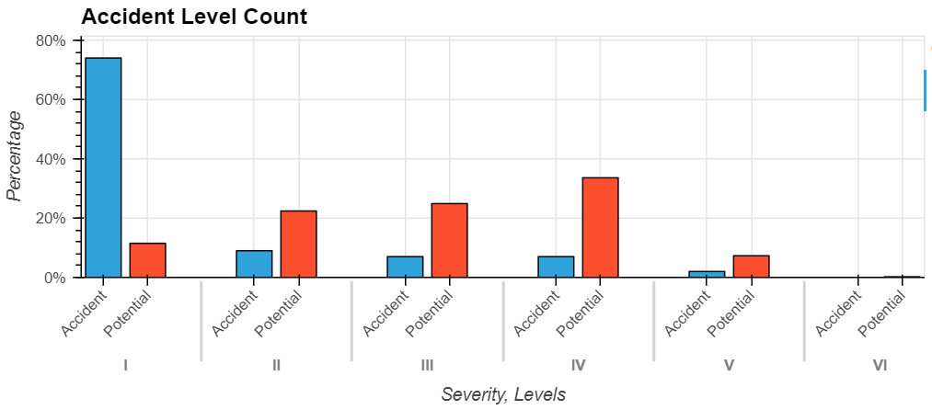
DATA analysis
Mining sector (most vulnerable) is dominated by Male whilst Metal sector is dominated by female workers due to nature of work
Third Party employees have high exposure to accidents; high employment ratio with low safety culture compared to direct employees
Severity of risk is in proportion to Potential Accident Level, which if overlooked may have adverse impact

Slide 4
MODEL PERFORMANCE
Neural Network Tune
Neural Network
SGD Classifier SMOTE
Random Forest Classifier SMOTE; Bagging Classifier SMOTE
Random Forest Classifier
Bagging Classifier; LSTM NN; Bernoulli NB
Decision Tree Classifier
Random Forest Classifier GloVe
Bernoulli NB SMOTE
Decision Classifier SMOTE
Bidirectional LSTM
0.48
0.47
Accuracy Score
0.45
0.42
0.41
0.40
0.36
0.34
0.33
0.30
0.29
Potential Accident Level chosen as Target Variable instead of Accident Level due to insufficient data points for severity level that caused biasness and in turn low accuracy
ML and Neural Network - Decision Tree Classifier delivers highest accuracy (42%) among all models with raw data; however accuracy improved to 47% for Bernoulli on up sampling of data using SMOTE
Deep Learning Model - Bidirectional LSTM outperforms all the models without applying SMOTE hence preferred to be used in Chatbot

Slide 5
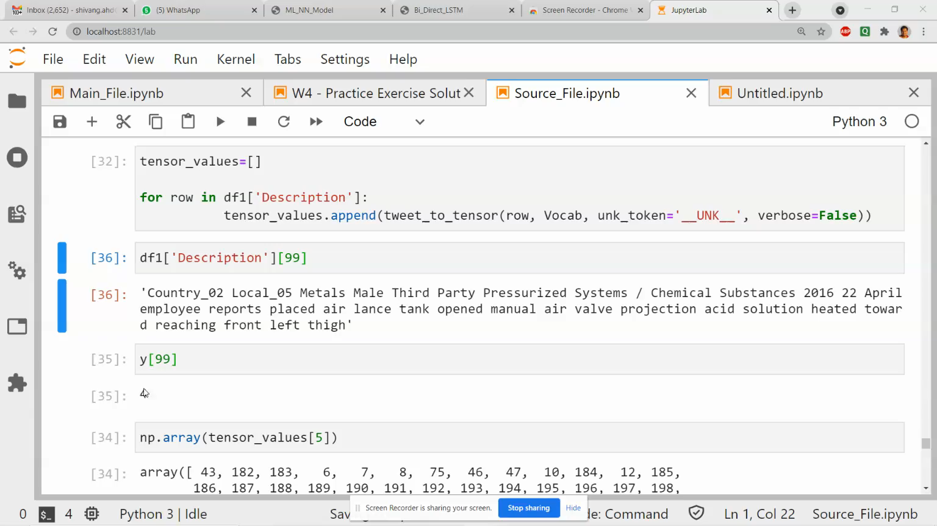
CHATBOT - Demo

